Slide 1























Node 1
$$w_{12}^{j}$$
$$w_{1k}^{j}$$
$$w_{11}^{j}$$
thread$1$
Assuming 64 threads, each with k sequential minibatch updates
$$w_{21}^{j}$$
$$w_{22}^{j}$$
$$w_{2k}^{j}$$
thread$2$
$$w^{j+1}=\frac{1}{64}\sum_{i=1}^{64}{w_{ik}^{j}}$$
$$∆w=w^{j+1}−w^{j}$$
$$w^{j}$$
…
Minibatch SGD
$$w_{63,1}^{j}$$
$$w_{63,2}^{j}$$
$$w_{63,k}^{j}$$
thread$63$
$$w^{∗}$$
$$∆w$$
$$w_{64,1}^{j}$$
$$w_{64,2}^{j}$$
$$w_{64,k}^{j}$$
thread$64$
$${w^{∗}=w}^{j}−η∆w$$
Node 0 : Host $(w^{∗})$
Node 2
Node 3
……
Node 6
Node 7

Slide 2
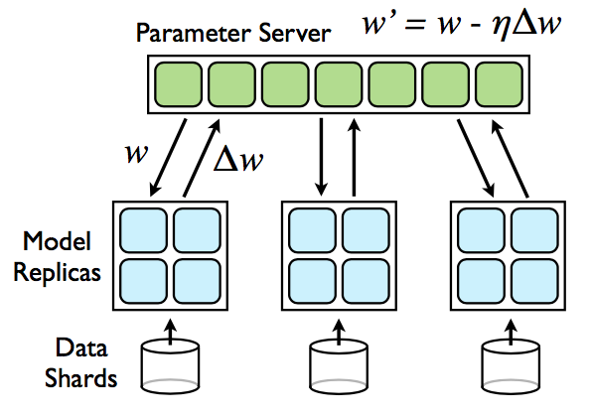
Downpour SGD. Model replicas asynchronously fetch parameters w and push $∆w$ to the parameter server.

Slide 3
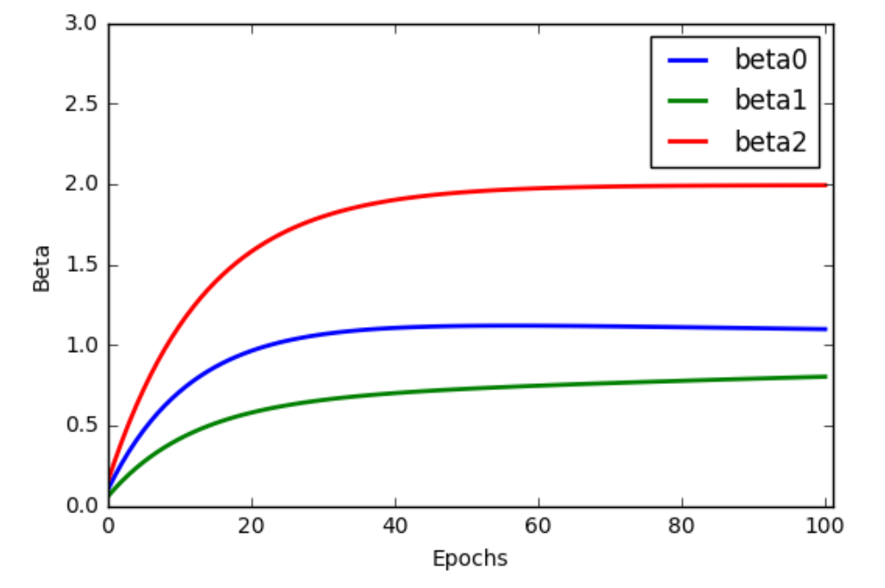

Slide 4
